Slide 1
Visual Workflow

Slide 2
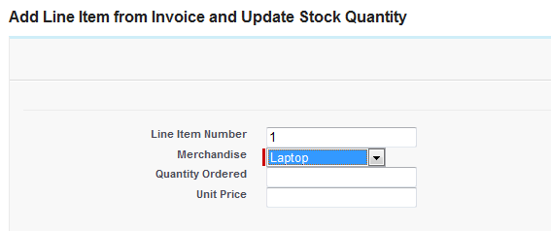
Visual Workflow
Visual Workflow enables you to build applications, known as flows, to guide users through screens for collecting and updating data.
You can visually build flows using the drag-and-drop user interface of the Cloud Flow Designer. No coding required!
Note: Visual Workflow isn’t supported in Salesforce1.

Slide 3
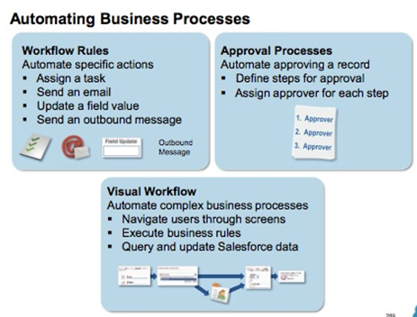
Automating Business Process

Slide 4
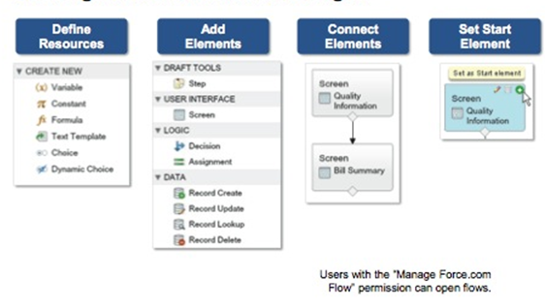
Building a Flow in Cloud Flow Designer

Slide 5
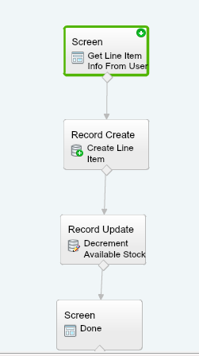
Add Line Item and Update Total Inventory

Slide 6
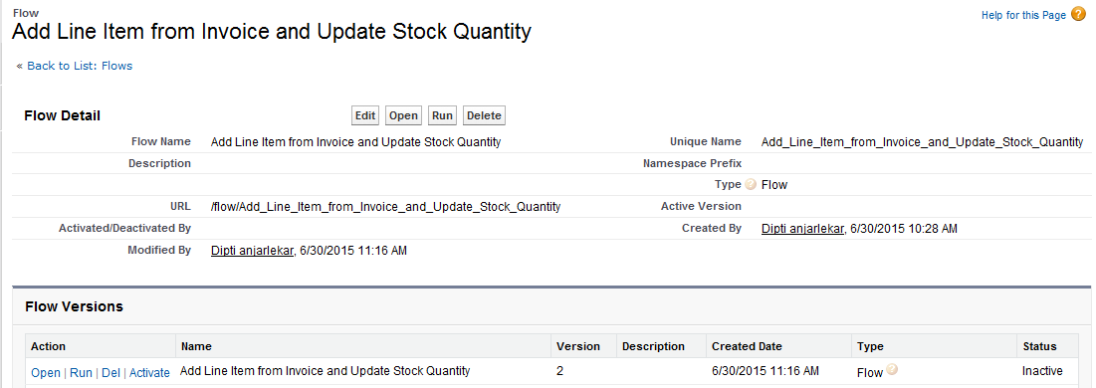
Deploy The Flow

Slide 7
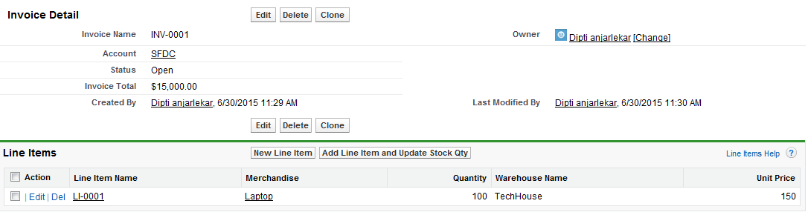
Add Line Item and Update the Stock Qty

Slide 8
Lab
In the lab you will:
Create And Deploy a Flow
Notes:
Labs and Troubleshooting:
<Summarize the tasks the students will perform in this lab. Suggest specific guidance the instructor may provide if necessary to help the students complete the lab and avoid trouble spots.>

